Slide 1
Phase 2
Foxtrot
2nd Lt Claire Badger
2nd Lt Mark Demore
2nd Lt Brandon Garland

Slide 2
Group Steps to Complete Deliverable
Enumerate steps taken by group to accomplish deliverable
Badger- Tracking, orientation, key presses
Demore- Radar Sensor
Garland- Lambdas/integration
All- debugging and putting the pieces together
What issues arose based on preliminary plan?
Problems getting behind on our timeline

Slide 3
Design Decisions
Justify your Software Quality Attributes
Fundamentally sound
Phase 2 structure was pretty much laid out for us
Made sure the manufacturer supplied pieces were used but not altered (similar to the real world)
Which Software Quality Attributes did you prioritize first?
Performance
Scalability
Modifiability
What Patterns did your group employ? Why?
Factory pattern present in WORadarSensor
Strategy pattern still employed in MotionStrategy

Slide 4
Lessons Learned
What worked?
Group flow worked really well
No major merge conflicts
What did not?
Timeline
Understanding what other people worked on
If you could send a message back through time, what would you tell your group?
Start earlier, even if it’s just looking at the code and understanding
Be better at math

Slide 5
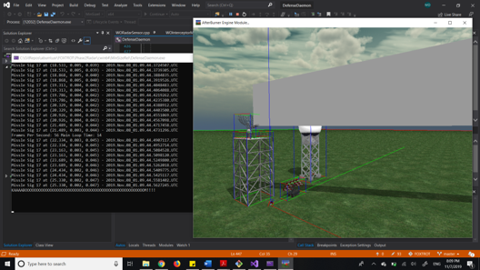
Demo/ Performance Analysis
When does it fail?
Tracking can be shaky
When does it work?
The rest of the time

Slide 6
Team Hours and Morale
Lt Badger(11 hrs)
Time sinks: tracking
Current morale: high
Lt Garland(11 hrs)
Time sink: displacement of sensor from origin
Current morale: Medium
Lt Demore(11 hrs)
Time sink: hyperplane math
Current morale: Medium

Slide 7
Grading
54/60
Functional Reqs ( 18 / 18 )
Commands
Key presses performed properly
Parses config and updates as expected
Design
Callbacks / lambdas function as expected
Spherical vs non-spherical
Polar coordinate conversion functions properly
Code Quality / Style / Software Attributes ( 13 / 18 )
Good WORadarSensor implementation for collision
A few missing nullptr checks -2
Crash on Exit – double deleting a WO – sensor in worldLst and RadarDish child list? -3
Template warnings during compilation -1
Git Logs / Group Work ( 12 / 12 )
Proper GIT usage
Presentation ( 11 of 12)
Conveyed development process successfully
Distributed work via GIT is noticeable.

